Slide 1


Data Management and Database Design
Logistics Management System
Group 4
Presented by:
Sachin Pawar
Abhinav Choudhary
Anutej Poddaturi
Rohan Teja Veeramachaneni
Jeel Kanzaria

Slide 2

Background
The rapid expansion of global trade, advancements in transportation, and the advent of information technology have revolutionized the logistics landscape.
In the early days, logistics management primarily involved manual processes, relying on pen-and-paper records and human coordination. However, with the proliferation of computers and the internet, logistics management systems have transitioned into digital platforms that leverage automation, data analytics, and real-time communication.
The rise of e-commerce and consumer expectations for fast and reliable deliveries has further driven the demand for efficient logistics management solutions.
Companies now face the challenge of handling complex supply chains, multiple transportation modes, global distribution networks, and the need for seamless integration with suppliers and partners.
As a result, logistics management systems have become an integral part of supply chain management, enabling businesses to gain better control over their operations, reduce costs, improve customer service, and adapt to the ever-changing demands of the market.

Slide 3
Logistics Management System
Objective
Business Challenges
Business Rules

Slide 4
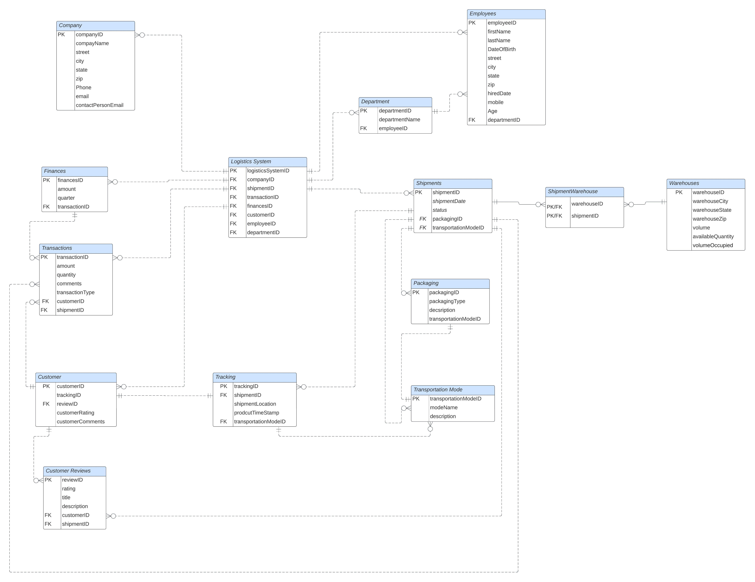
Entity
Relationship
Diagram

Slide 5
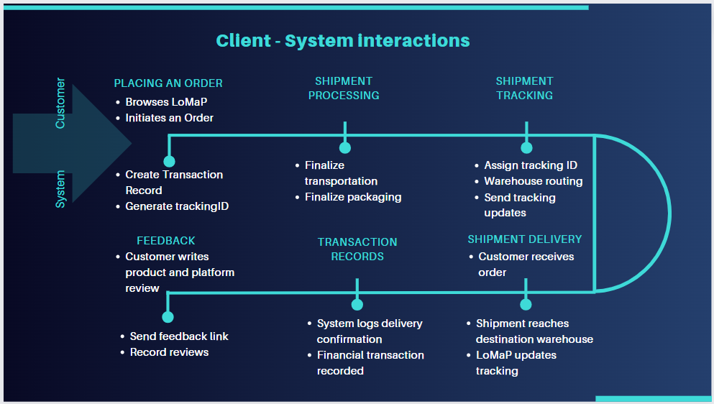

Slide 6
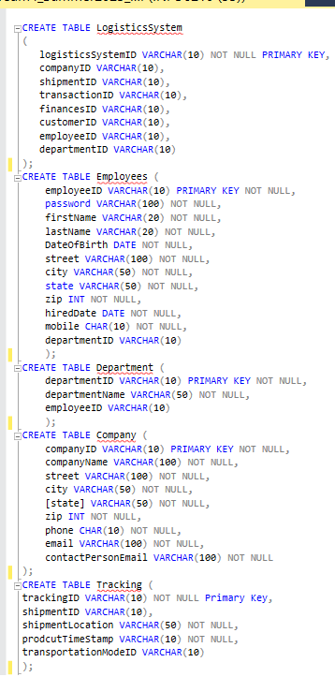
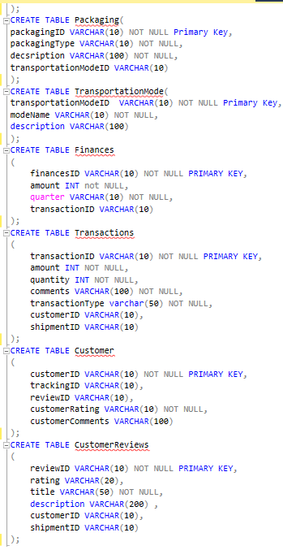
SQL DDL Create
The core of the entire system is the Logistics System table, serving as the central point of connection to various other tables, including Shipments, Customers, Finances, Employees, and more.

Slide 7
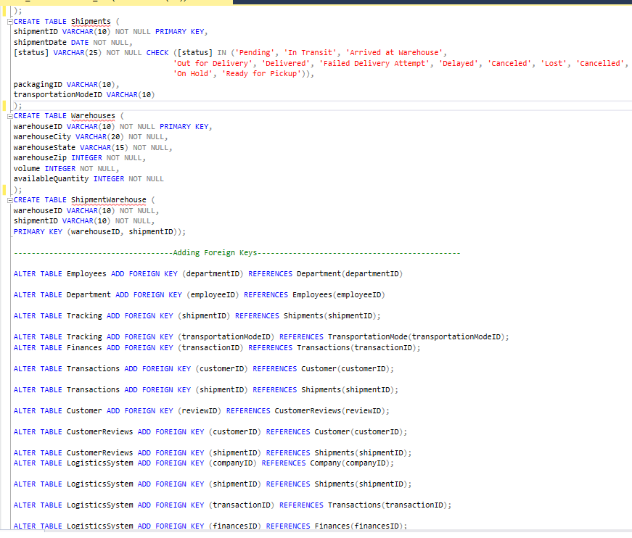
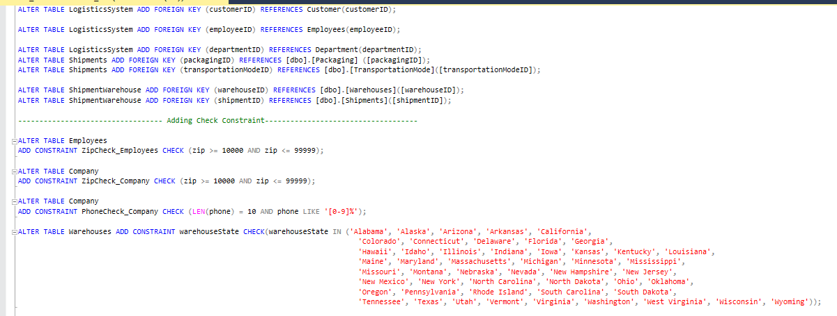
SQL DDL Alter
Using Alter to update the relationships between entities using Foreign Keys, as well as to add constraints on tables wherever necessary.

Slide 8
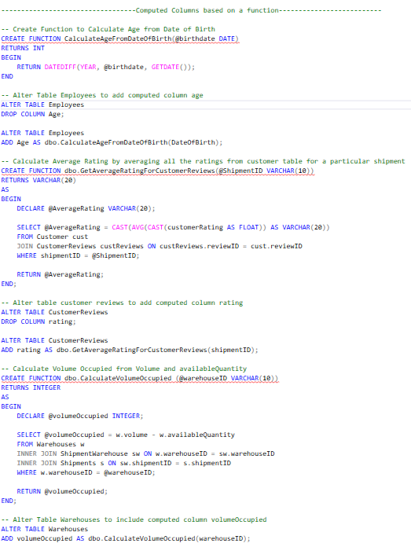
Functions

Slide 9
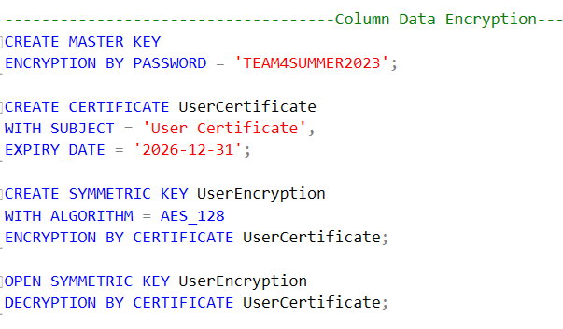
Encryption
We have used Symmetric Encryption with Advanced Encryption Standard (AES) algorithm using a key length of 128 bits (AES-128)

Slide 10
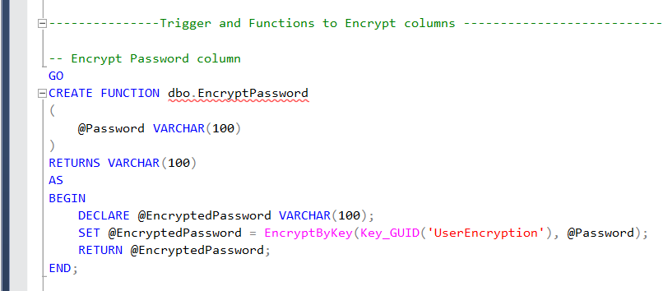
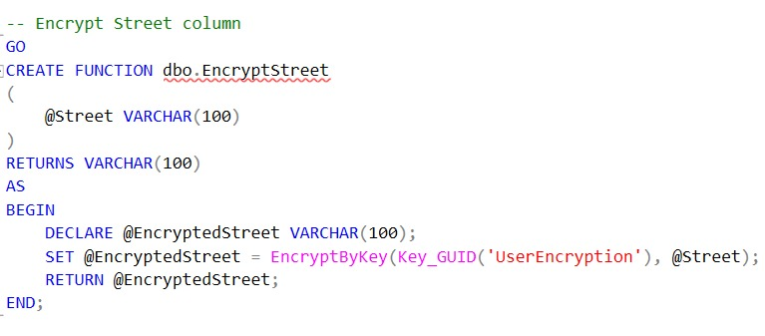
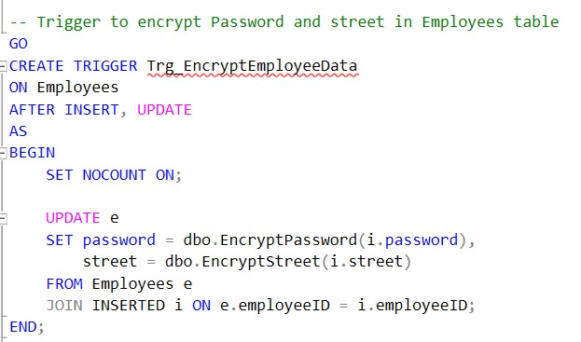
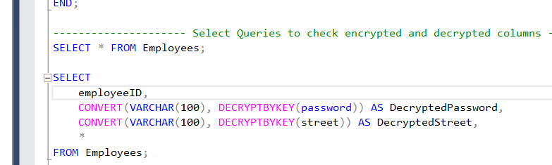
Encryption
Trigger and Functions were used for inserting data into User Entity with Password Encryption .
DECRYPTBYKEY (Transact-SQL) was used to get the Actual Password from an Encrypted form .

Slide 11
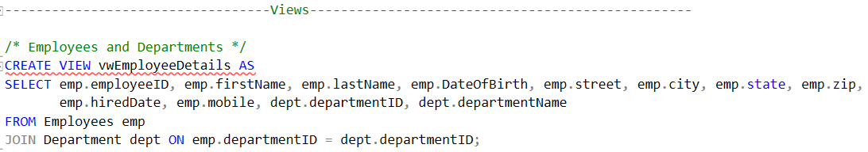
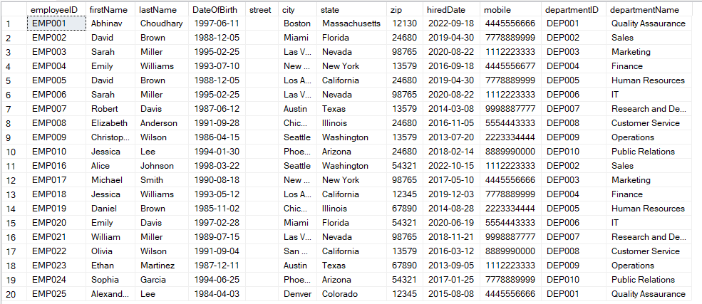
Views
Employee Details

Slide 12
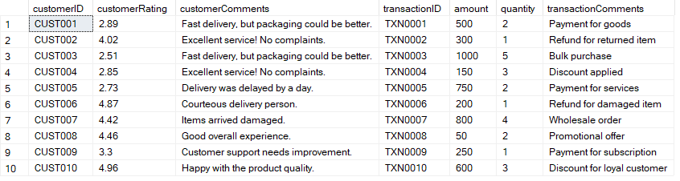
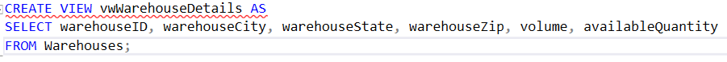
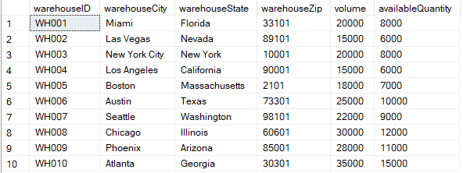
Views
Customer Transactions
Warehouse Details

Slide 13
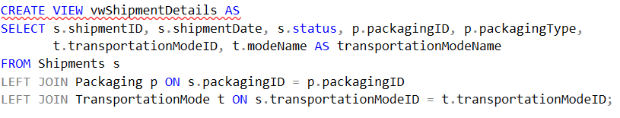
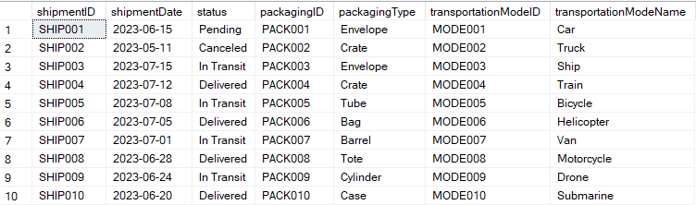
Views
Shipment Details

Slide 14
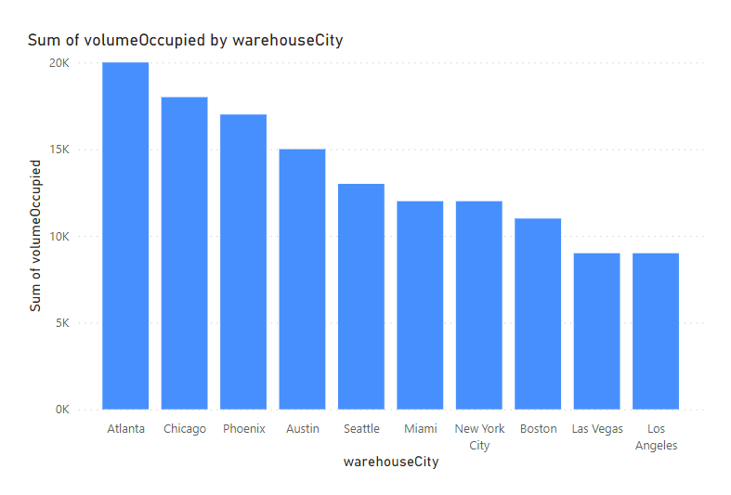
Reports and Visualization
Report shows Volume Usage of each City Warehouse.
WarehouseCity is on the X-axis
VolumeOccupied is on the Y-Axis

Slide 15
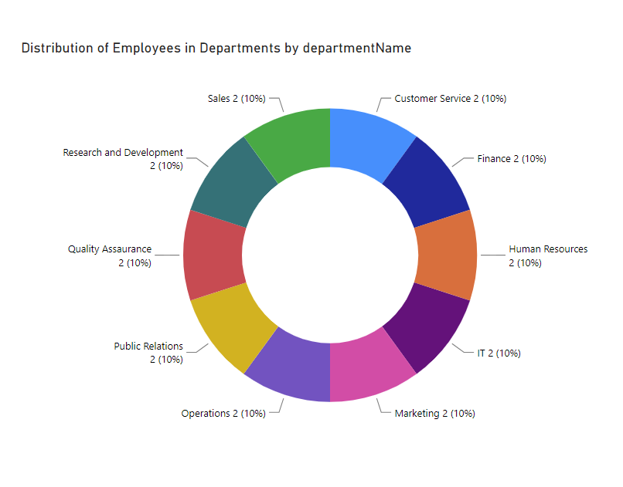
Reports and Visualization
Report shows the Distribution of employees in various Departments.
Count is shown in separate segments of the donut chart along with the department name.

Slide 16
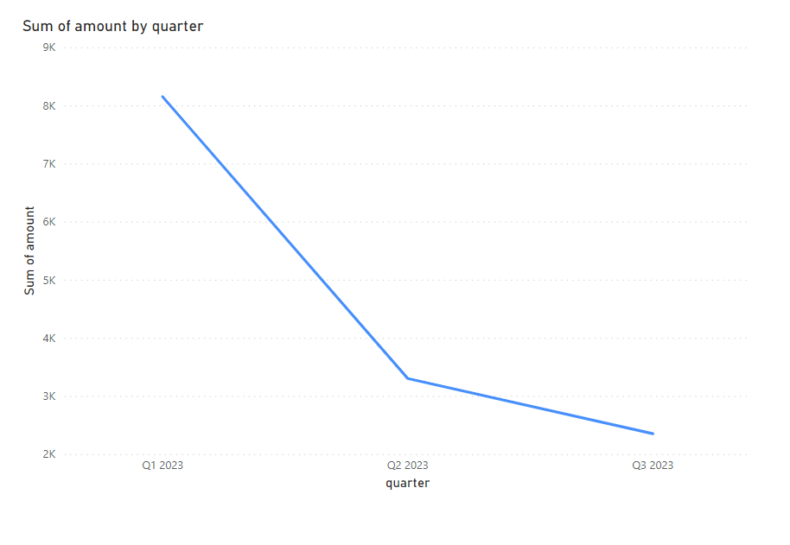
Reports and Visualization
Report shows the Total amount for each quarter.
Quarter on the x-axis.
Total Amount on the Y-Axis.

Slide 17

Any questions ?

Slide 18

Thank you

